Slide 1
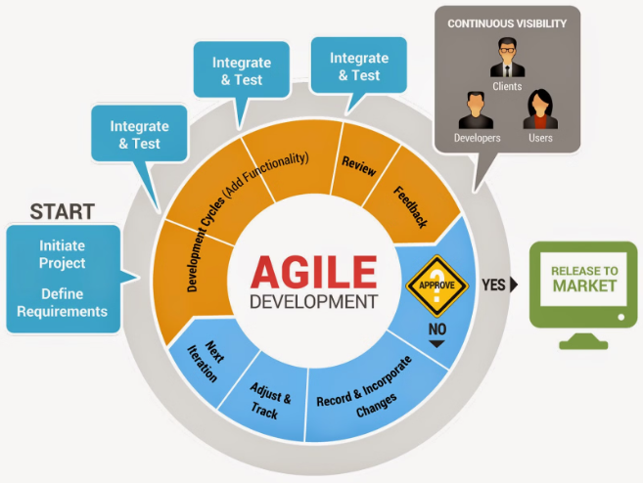
Software Development Life Cycle (SDLC) Phases and Models
Understanding the Lifecycle and Comparing Models
Presenter's Name: Shubham Singh
Date: 07/06/2024

Slide 2
Introduction to SDLC
Definition:
SDLC is a structured process for developing software applications, consisting of a series of defined phases.
Purpose:
Ensure the delivery of high-quality software that meets or exceeds customer expectations.
Provide a framework for planning, creating, testing, and deploying software.

Slide 3
SDLC Phases
Planning
Requirements Analysis
Design
Implementation (Coding)
Define project scope and objectives.
Design system architecture and components.
Gather and analyze user requirements.
Convert design documents into executable code.
Conduct feasibility study and risk analysis.
Document functional and non-functional requirements.
Create detailed design documents.
Develop software components and modules.
Develop project plan and schedule.
Plan for system interfaces, databases, and user interfaces.
Create requirement specification documents.
Follow coding standards and guidelines.

Slide 4
SDLC Phases
Testing
Deployment
Maintenance
Conduct various levels of testing (unit, integration, system, acceptance)
Release the software to production
Provide ongoing support and bug fixes
Conduct user training and documentation
Implement enhancements and updates
Identify and fix defects
Ensure the software meets requirements and is bug-free
Monitor system performance and user feedback
Ensure software continues to meet user needs

Slide 5





SDLC Models
Waterfall Model:
V-Model (Validation and Verification):
Iterative Model:
Develops software in small, incremental cycles.
Sequential design process.
Extension of the Waterfall model.
Each phase must be completed before the next begins.
Allows for partial implementation and early feedback.
Testing phase is parallel to development phase.
Simple and easy to manage.
Emphasizes verification and validation.
Reduces risks and improves product quality.
Spiral Model:
Agile Model:
Combines iterative development with risk assessment.
Emphasizes iterative and incremental development.
Each iteration involves planning, risk analysis, engineering, and evaluation.
Promotes collaboration, flexibility, and customer feedback.
Suitable for complex and high-risk projects.
Popular methodologies: Scrum, Kanban, XP.

Slide 6
Comparison of SDLC Model
Model
Pros
Cons
Waterfall
simple, easy to manage, clear stages
inflexible, late testing, difficult to
accomodate changes.
V-model
emphasizes testing, easy to manage
similar cons to waterfall, less flexibility
Iterative
early detection of issues, user feedback
require more resources
Spiral
risk management, flexibility
complex, expensive, require expertise
Agile
high flexibility, customer centric
high collaboration, less predictability

Slide 7
Choosing the Right Model
Project Size and Complexity:
Requirements Stability:
Waterfall for small, simple projects.
Waterfall or V-Model for stable requirements.
Agile or Iterative for large, complex projects.
Agile for dynamic, evolving requirements.
Risk Management:
Team and Stakeholder Involvement:
Spiral for projects with significant risks.
Agile for high collaboration and active stakeholder engagement.
Agile for projects needing rapid iterations and feedback.
Waterfall for minimal stakeholder involvement.

Slide 8
Thank you

